Slide 1

Topic Mining Modelling
Team A2
Group members: Chen Xi, Chengcheng Cai, Yiran Li, Jiayi Wang, Jingyi Liu
Collaborating with ALLINDEX

Slide 2
Content
Introduction
Dataset
Model building
Visualization
Dynamic Modelling
Model Workflow
Portfolio Example

Slide 3
Introduction

Slide 4
Introduction
Background: ALLTopics is a specialised search engine to find listed companies associated with a certain topic. Results from the search engine are fed into a backtesting tool as well as into LLM to create a research report. All components except topic mining are live in production at ALLINDEX.
First Phase (Topic Mining)
Second Phase (Investment Decision)
ALLINDEX GPT
Research Reports
News
ALLTopicsTopic Mining
ALLINDEX FINDALL
ALLINDEX backtesting
Other data
What we mainly solve!

Slide 5
Introduction
Existing Issues:
the number of topics needs to be predetermined before analysis;
the formed topics are not easily and intuitively understood.
Goal:
Design a new dynamic topic-mining framework
Identify meaningful topics in news articles and show their progression over time
Approach:
Use NLP+LLM model for news topic detection

Slide 6
Dataset

Slide 7
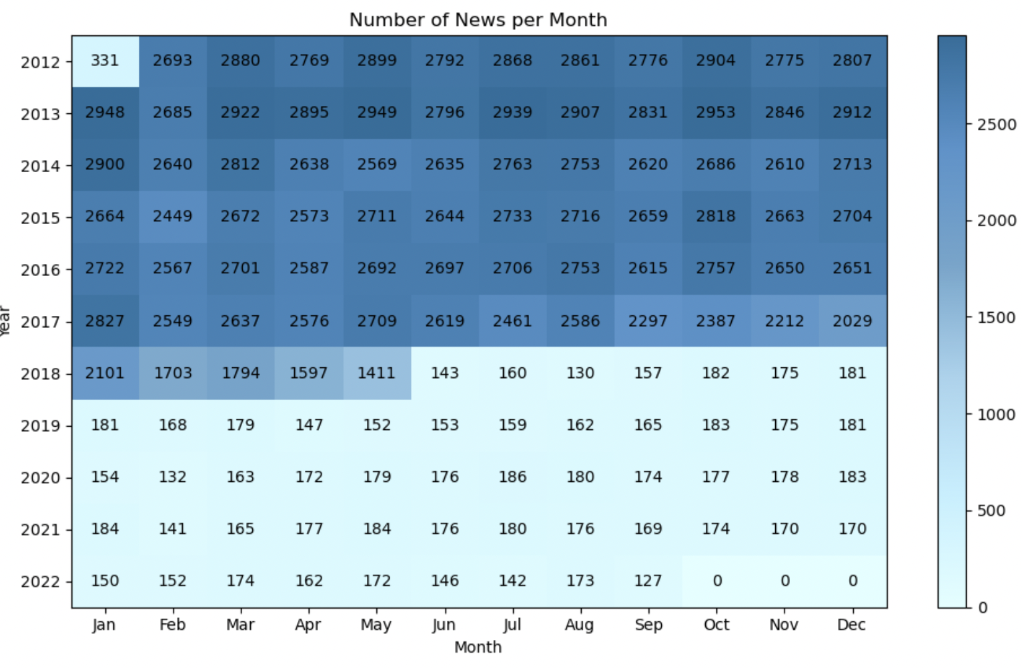
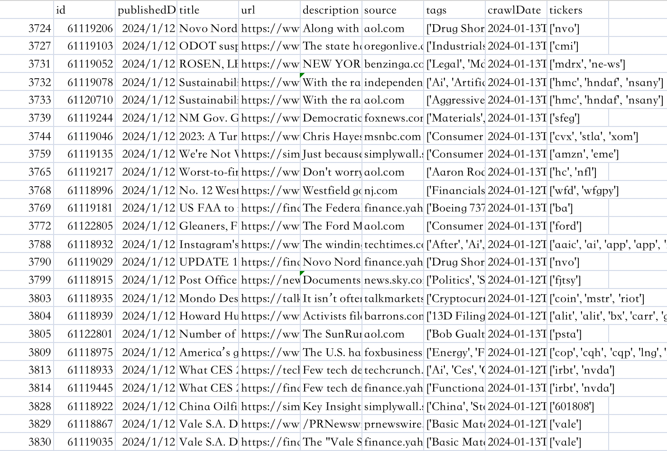
Dataset
Overview:
Approx. 210k headlines(non-null) from HuffPost. (Kaggle)
Timeframe:
Avg of 30,000 entries per year from 2012 to 2017
From 2018 to 2022, an average of 2,000 entries per year
Data Attributes:
Headline: Title of the news article.
Short Description: Summary of the article.
Others: Category, Date
Overview:
tiingo api
Timeframe:
Avg of 4000 entries per day(only English & tickers)
Data Attributes:
Title : Title of the news article.
Short Description: Summary of the article.
Others: id, published date, source, crawldate

Slide 8
Model Building
LDA
Bertopic + LLM

Slide 9
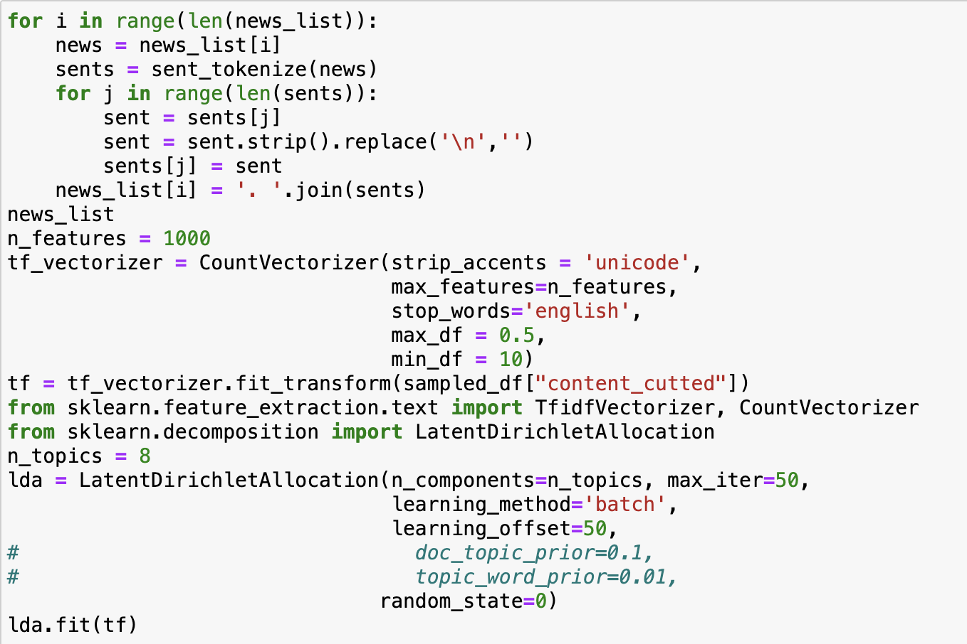
LDA
1.Preprocess Document
2. Tokenize words
3. Create Document-Term Matrix
4.Apply LDA
Perplexity：939.401

Slide 10
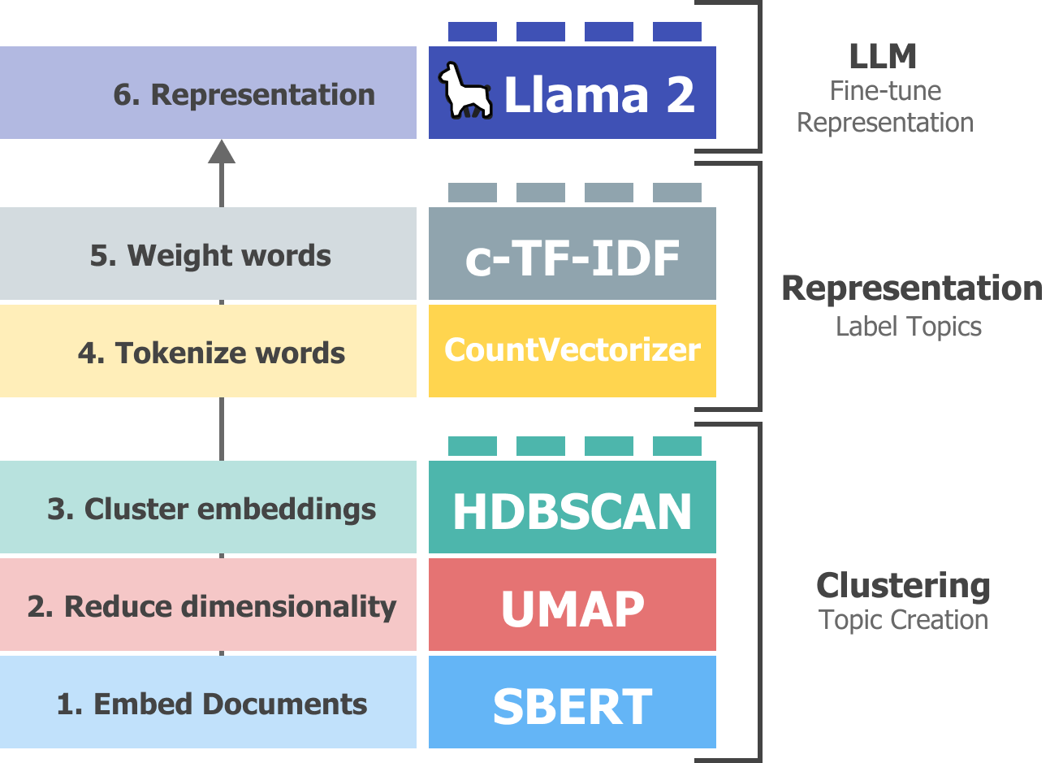

Bertopic + LLM
Embed Documents
BAAI/bge-small-en
2. Reduce dimensionality
UMAP
Topic Creation
3. Cluster embeddings
K-Means
4. Tokenize words
CountVectorizer
Representation
5. Weight words
c-TF-IDF
Fine-tune
Representation
6. Representation
LLM

Slide 11
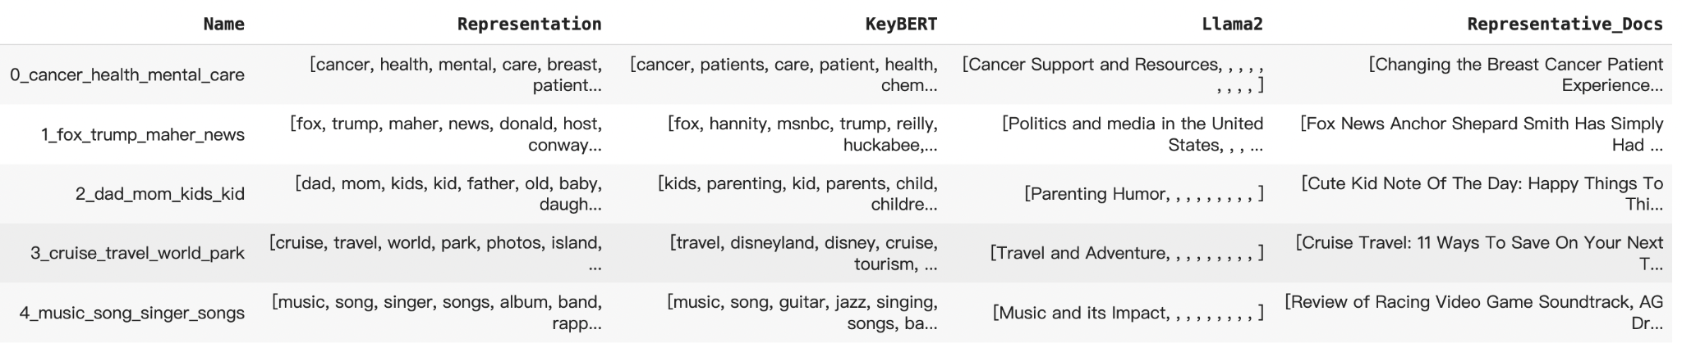
Bertopic + LLM
Comparison of Original Representation, KeyBert and LLAMA 2

Slide 12
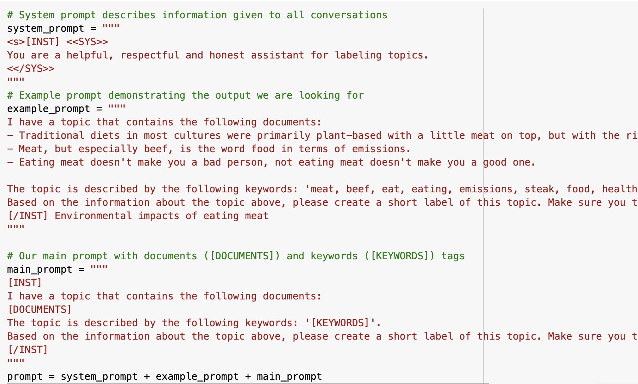
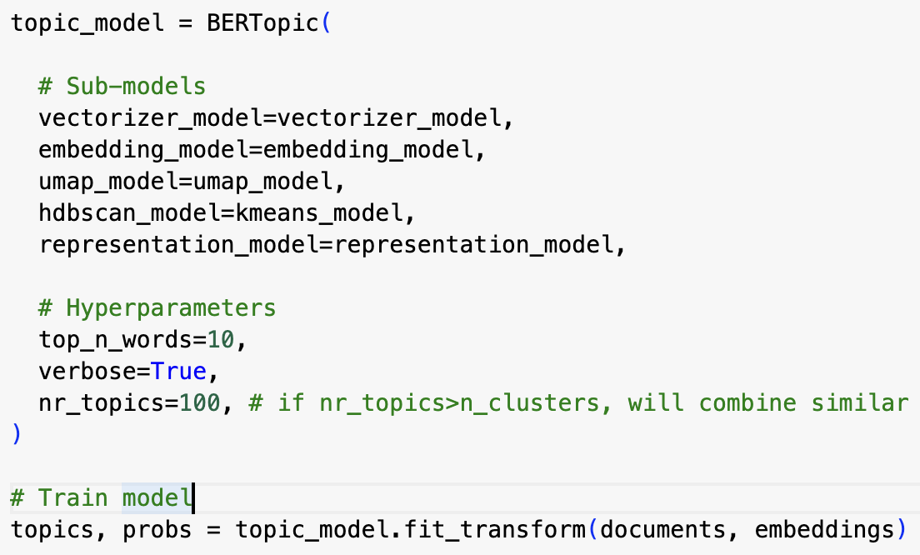
Bertopic + LLM
# Prompt Engineering
System prompt
Example prompt
Main prompt
# Submodel Parameter Setting
UMAP: neighbors=15, components=5
K-Means: clusters=100
Top_n_words:10; top_n_docs:5

Slide 13
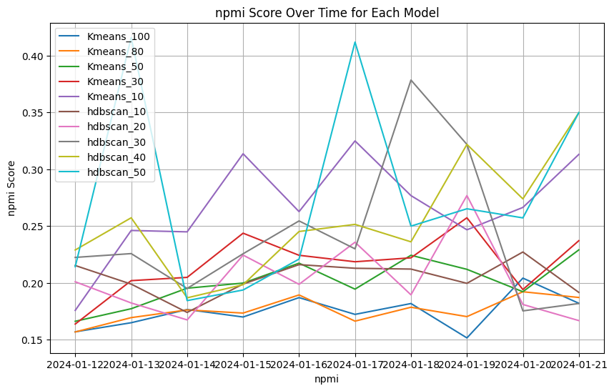
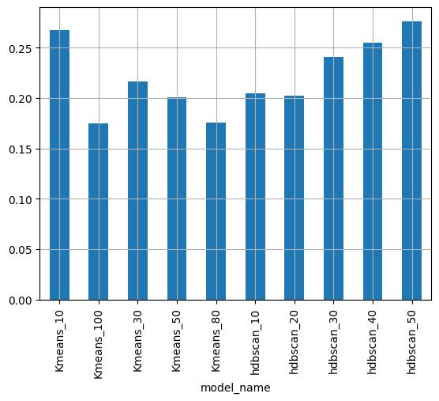
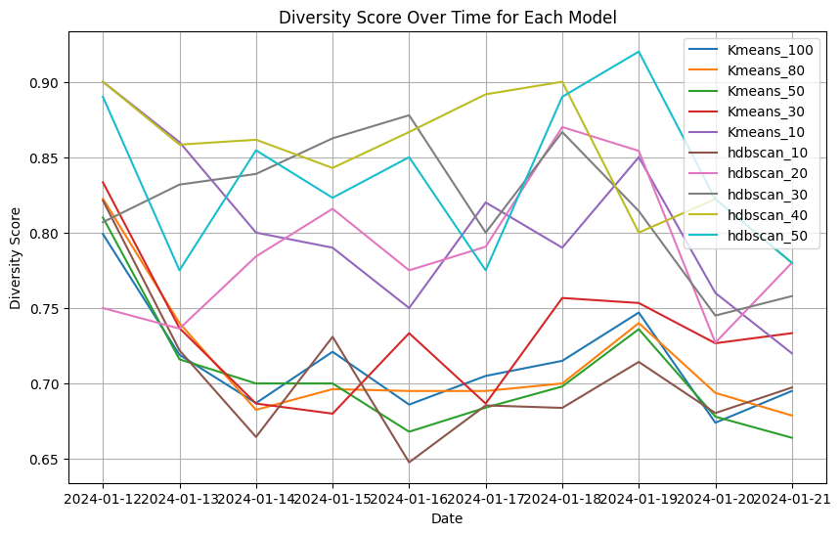
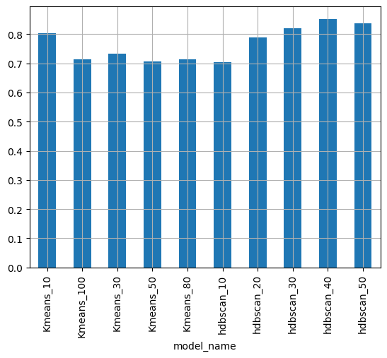
Evaluation
Calculate Coherence Score(NPMI) and Diversity Score under different clustering method(KMeans or HDBscan) and parameter(cluster_num or min_size) for different days
Hdbscan has the best performance, but it also yields a lot of outliers.
To make topic content more accurate, we restrict topic numbers being too little

Slide 14
Visualization

Slide 15
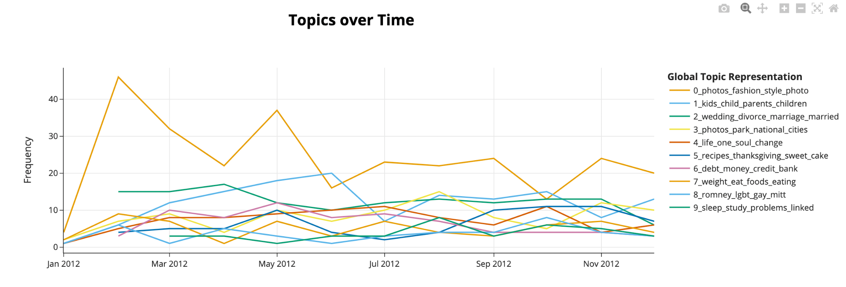
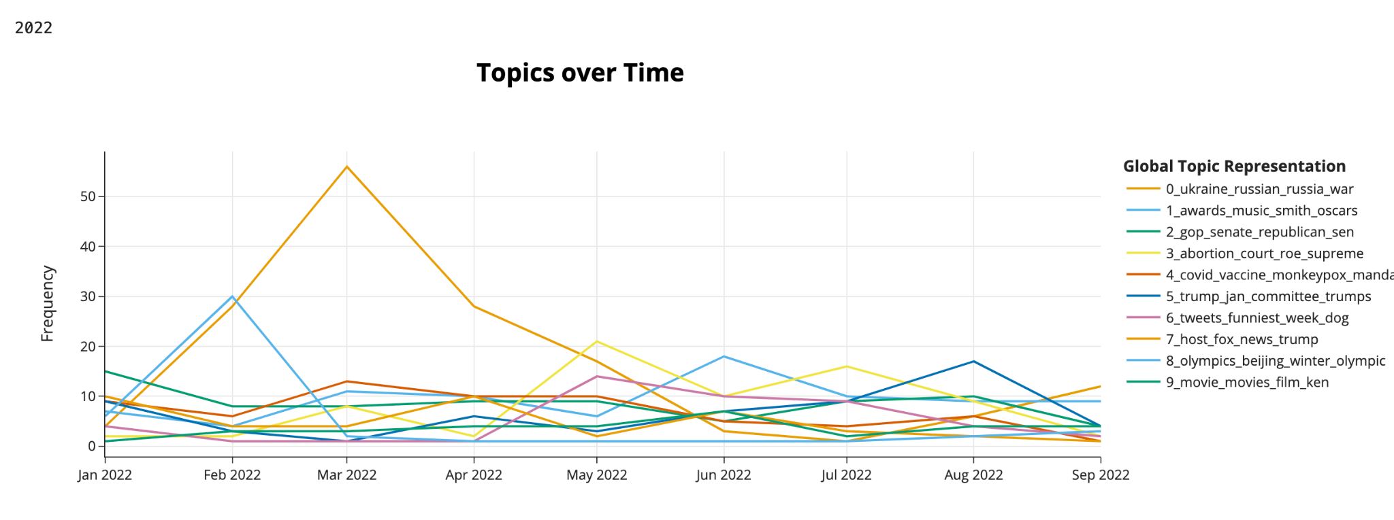
Visualization
2012
2022

Slide 16
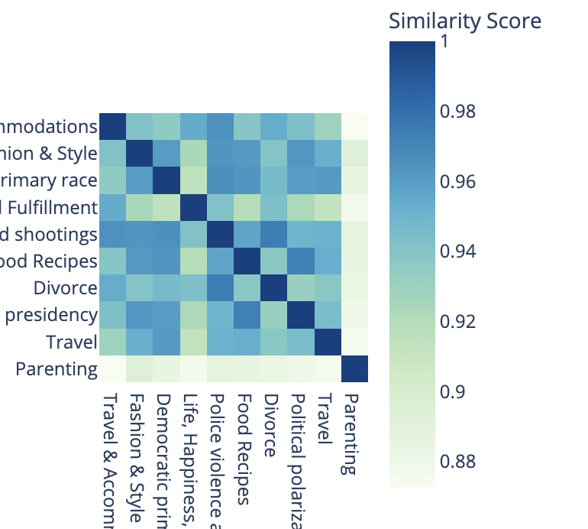
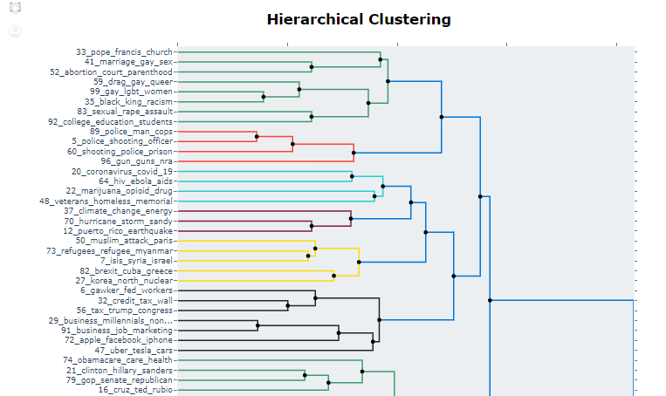
Visualization
Similarity of Topics
Hierarchical Clustering

Slide 17
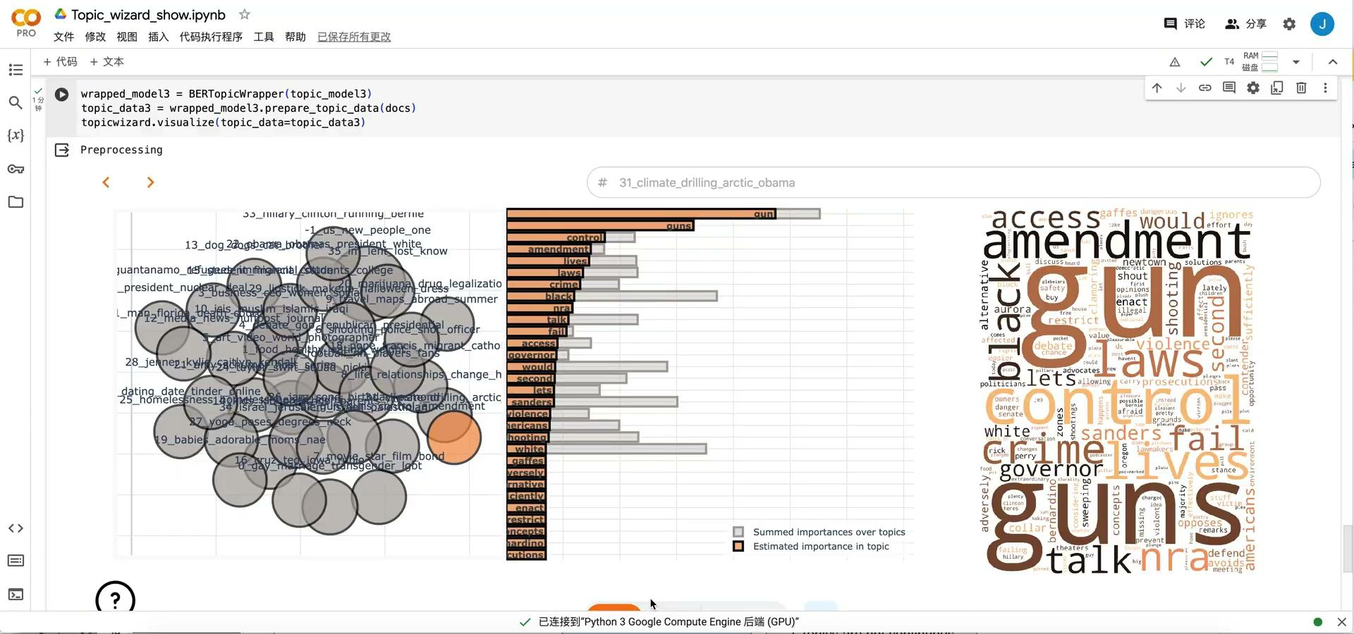
Visualization

Slide 18
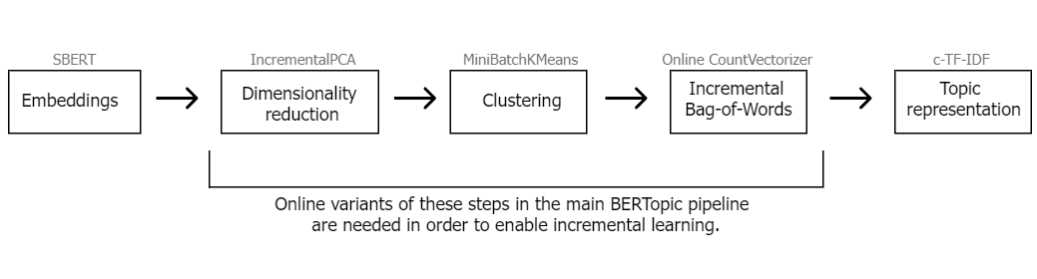
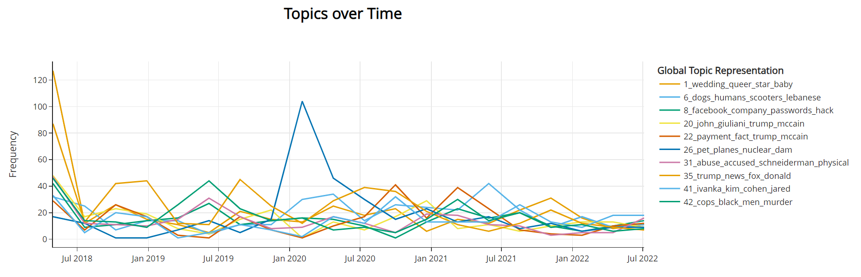
Dynamic Modelling
Online Bertopic
Incremental PCA
MiniBatchKMeans
model.partial_fit()
Pros:
1. More Accurate
2. Faster
Cons:
1.Topics are not continuous

Slide 19
Dynamic Modelling
Merge submodels: Combine new models into existing topic model based on similarity
BERTopic_1
Similarity
BERTopic_2
Merge
Topic Model
BERTopic_3
BERTopic_4
(New Sample)
Pros:
1. Topics are consistent
Cons:
1. Speed not fast
2. Less accurate than OB
Notes:
Topic Consistency: When merging models, some of the originally generated topics may be lost, especially if those topics are not very prominent or consistent across different data subsets. This can lead to a loss of valuable nuanced information.
Potential for Overgeneralization: There is a risk of overgeneralization when merging topics, as distinct but related topics may be combined into a broader category that does not capture the unique aspects of each original topic.

Slide 20
Workflow
workflow
method
Data Acquisition
Tiingo API
Data Acquisition and Cleaning
2. Data Cleaning
Deduplication & English Detection
4. Training Models
BERTopic
Model Training
5. Merge Models
Cosine Similarity
Fine-tune
Representation
6. Representation
LLM

Slide 21
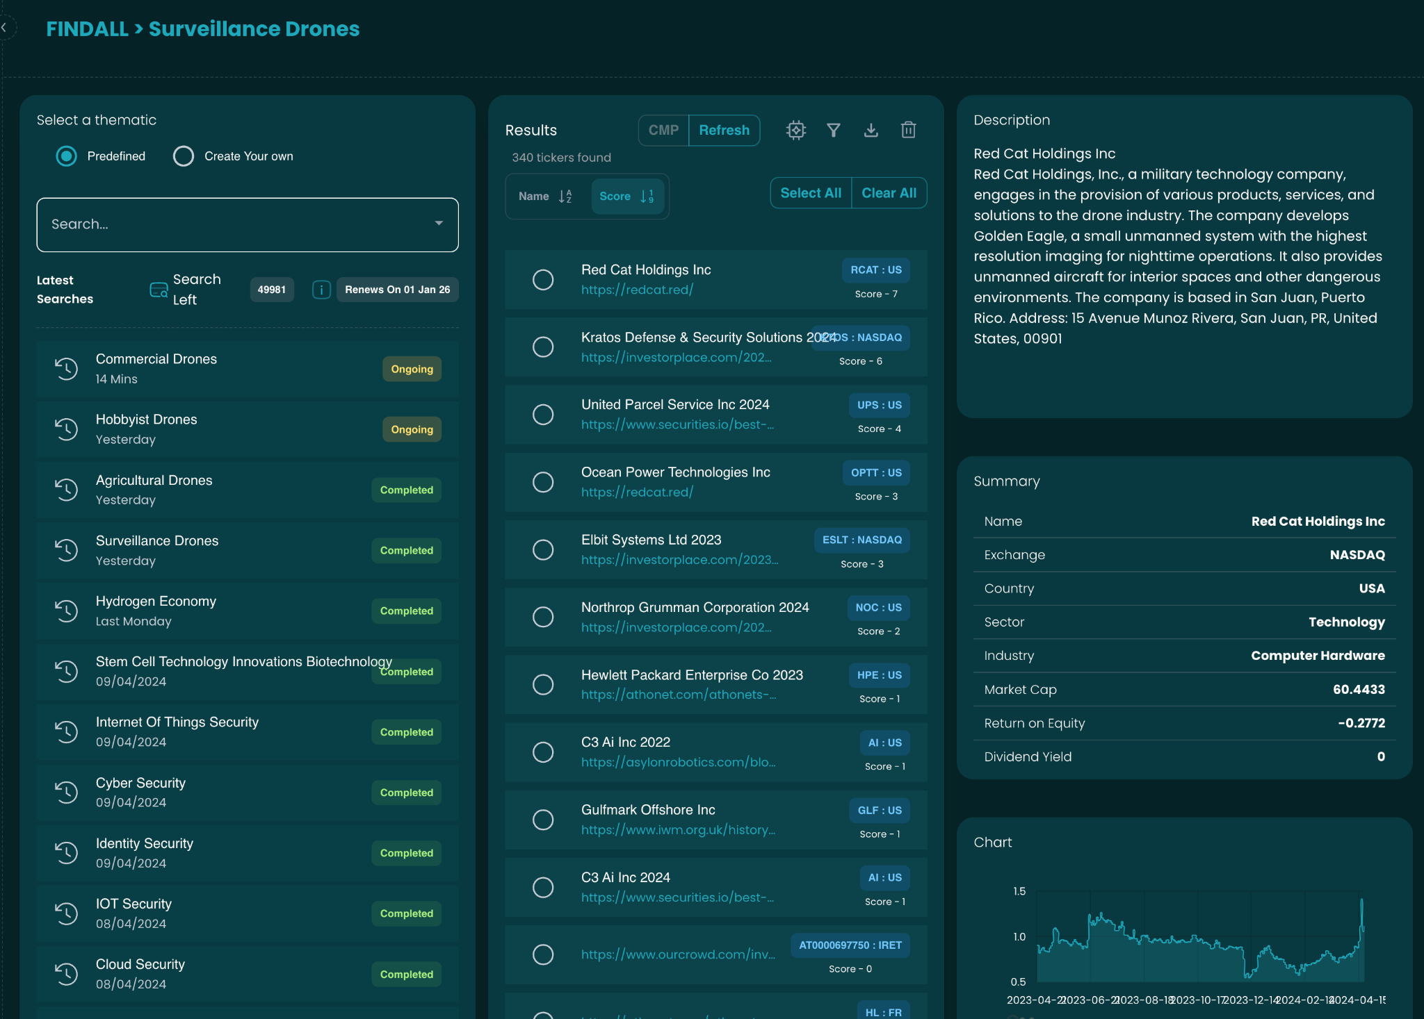
FINDALL
High Level Diagram of FINDALL
Input topic in FINDALL Bar
Use LLM to create search items
Download public sources (website, pdf, docx etc)
Feed web crawler with search items
Perform named entity recognition (NER)
Use transformer to understand context of NER
Display list of company and source used
Calculate likelihood that NER belongs to topic

Slide 22
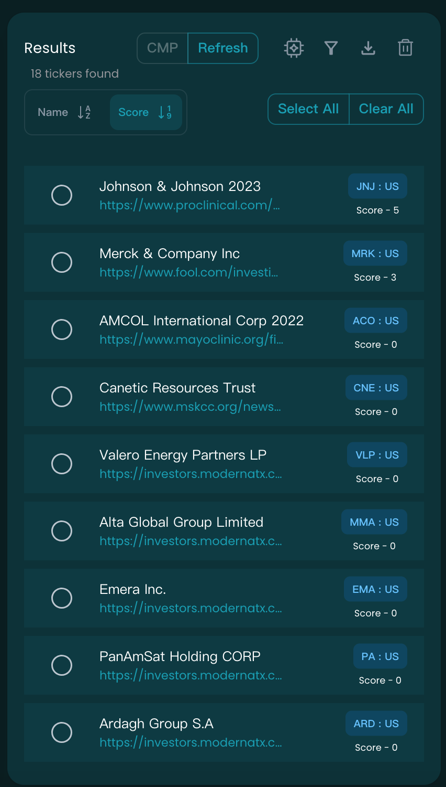
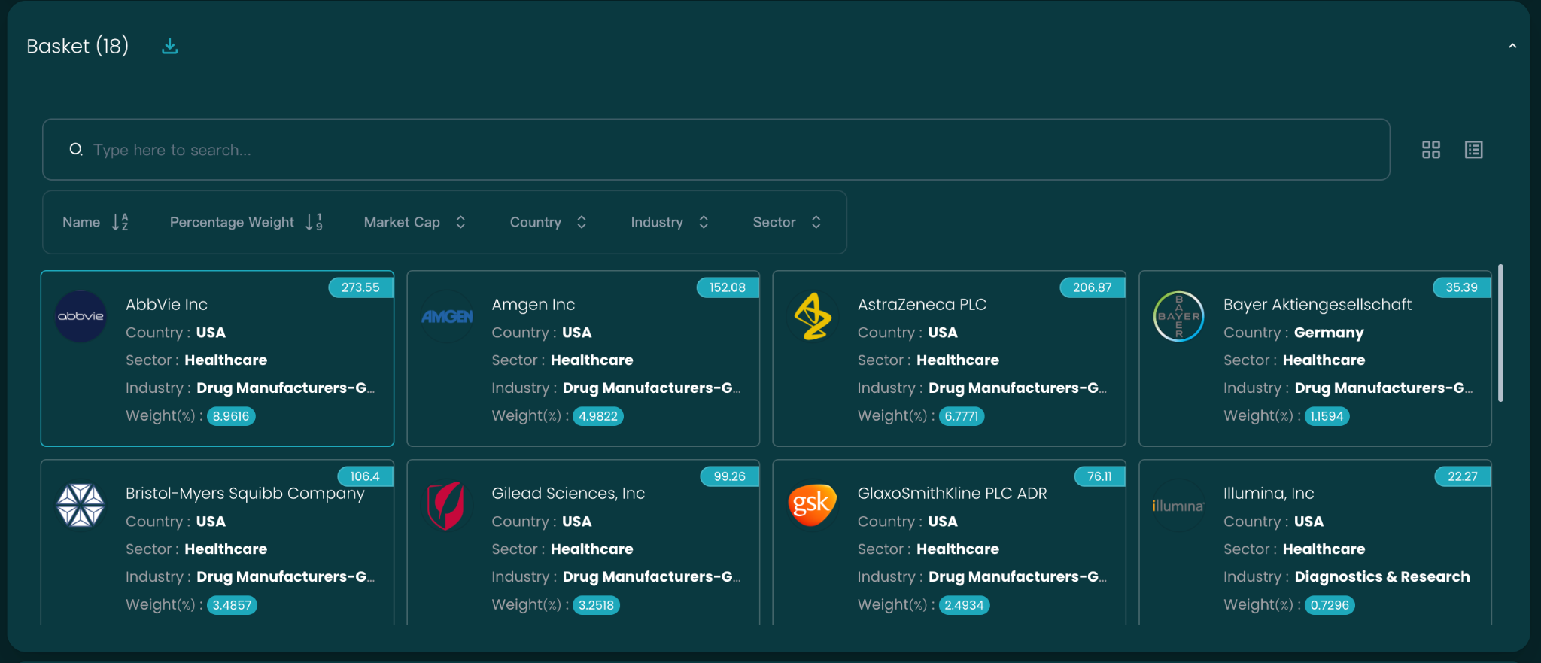
Portfolio Example
Topic Selection Criteria :
Topic that grows 300% compared to the previous day
Topic that is five times higher than the average frequency of the past seven days
Topic Keywords：
clinical cancer treatment fda
Find relevant stocks
Construct Portfolio

Slide 23
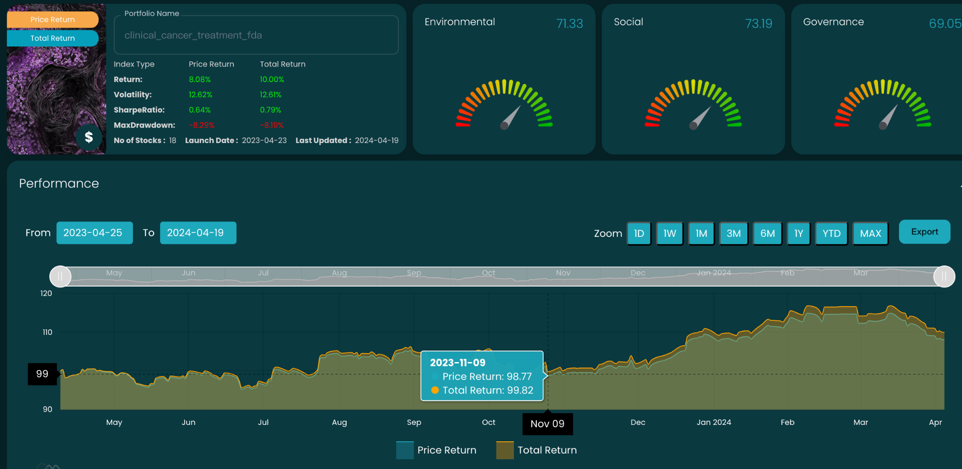
Portfolio Example
Backtest: Find Relevant Tickers and Create Portfolio using Topic Names
Topic Keywords: clinical, cancer, treatment, fda

Slide 24
Conclusion

Slide 25
Conclusion
We build a new dynamic topic-mining framework using Bertopic and LLM to Identify meaningful topics in news articles and show their progression over time
Firstly, we used kaggle data to train a initial model
Secondly, we employed up-to-date data(api) and designed a workflow employing cosine similarity to merge topics, ensuring coherence.
Lastly, we used findall function to construct our portfolio pools and make investment decision

